Slide 1
Running AWS locally with LocalStack
Bogdan Bujdea

Slide 2
Agenda
What is LocalStack
Installation
Configuration
Demo: Using LocalStack in .NET Core projects
Q&A

Slide 3
LocalStack
A fully functional local AWS cloud stack
Provides an easy-to-use test/mocking framework for developing Cloud applications
Simplifies the onboarding process

Slide 4
Advantages
Actual HTTP REST services
Language agnostic
Error injection
Isolated processes
Pluggable services
Notes:
Actual HTTP REST services: All services in LocalStack allow actual HTTP connections on a TCP port.
Language agnostic: Although LocalStack is written in Python, it works well with arbitrary programming languages and environments, due to the fact that we are using the actual REST APIs via HTTP.
Error injection: LocalStack allows injection of the errors that frequently occur in real cloud environments — for instance, ProvisionedThroughputExceededException, which is thrown by Kinesis or DynamoDB if the amount of read/write throughput is exceeded.
Isolated processes: All services in LocalStack run in separate processes. The overhead of additional processes is negligible, and the entire stack can easily be executed on any developer machine and CI server. LocalStack services live in isolation as separate processes available via HTTP, which fosters true decoupling and more closely resembles the real cloud environment.
Pluggable services: All services in LocalStack are easily pluggable and replaceable, due to the fact that we are using isolated processes for each service. This allows us to keep the framework up-to-date and mock whatever service we want. So you can have parts of your app communicating with AWS, and some of them can use mocks provided by localstack.

Slide 5
Requirements
python(either 2.x or 3.x)
pip (python package manager)
Docker

Slide 6
Installation

Slide 7
Pip
> pip install localstack

Slide 8
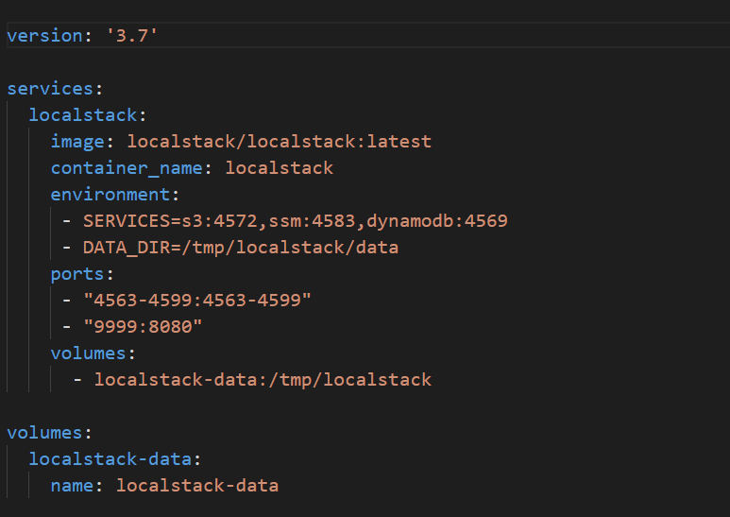
docker-compose.yaml

Slide 9
Configuration

Slide 10
Configurations
Using environment variables like:
SERVICES, DEFAULT_REGION, etc.
https://github.com/localstack/localstack#configurations

Slide 11
Dynamically updating configuration at runtime
aws --endpoint-url=http://localhost:4583 ssm put-parameter --name “/demo/settings/intervalInSeconds" --type String --value "60" --overwrite --region "us-east-1"

Slide 12
DEMO TIME

Slide 13
Thank you Q&A

